Slide 1
Quarry & Pit Valuations Do You Add Value?
Art Pincomb, ASA, CPG
Associated Geologists, Inc.
www.mineralvaluation.com
April 12, 2018

Slide 2

Associated Geologist(s), Inc.

Slide 3
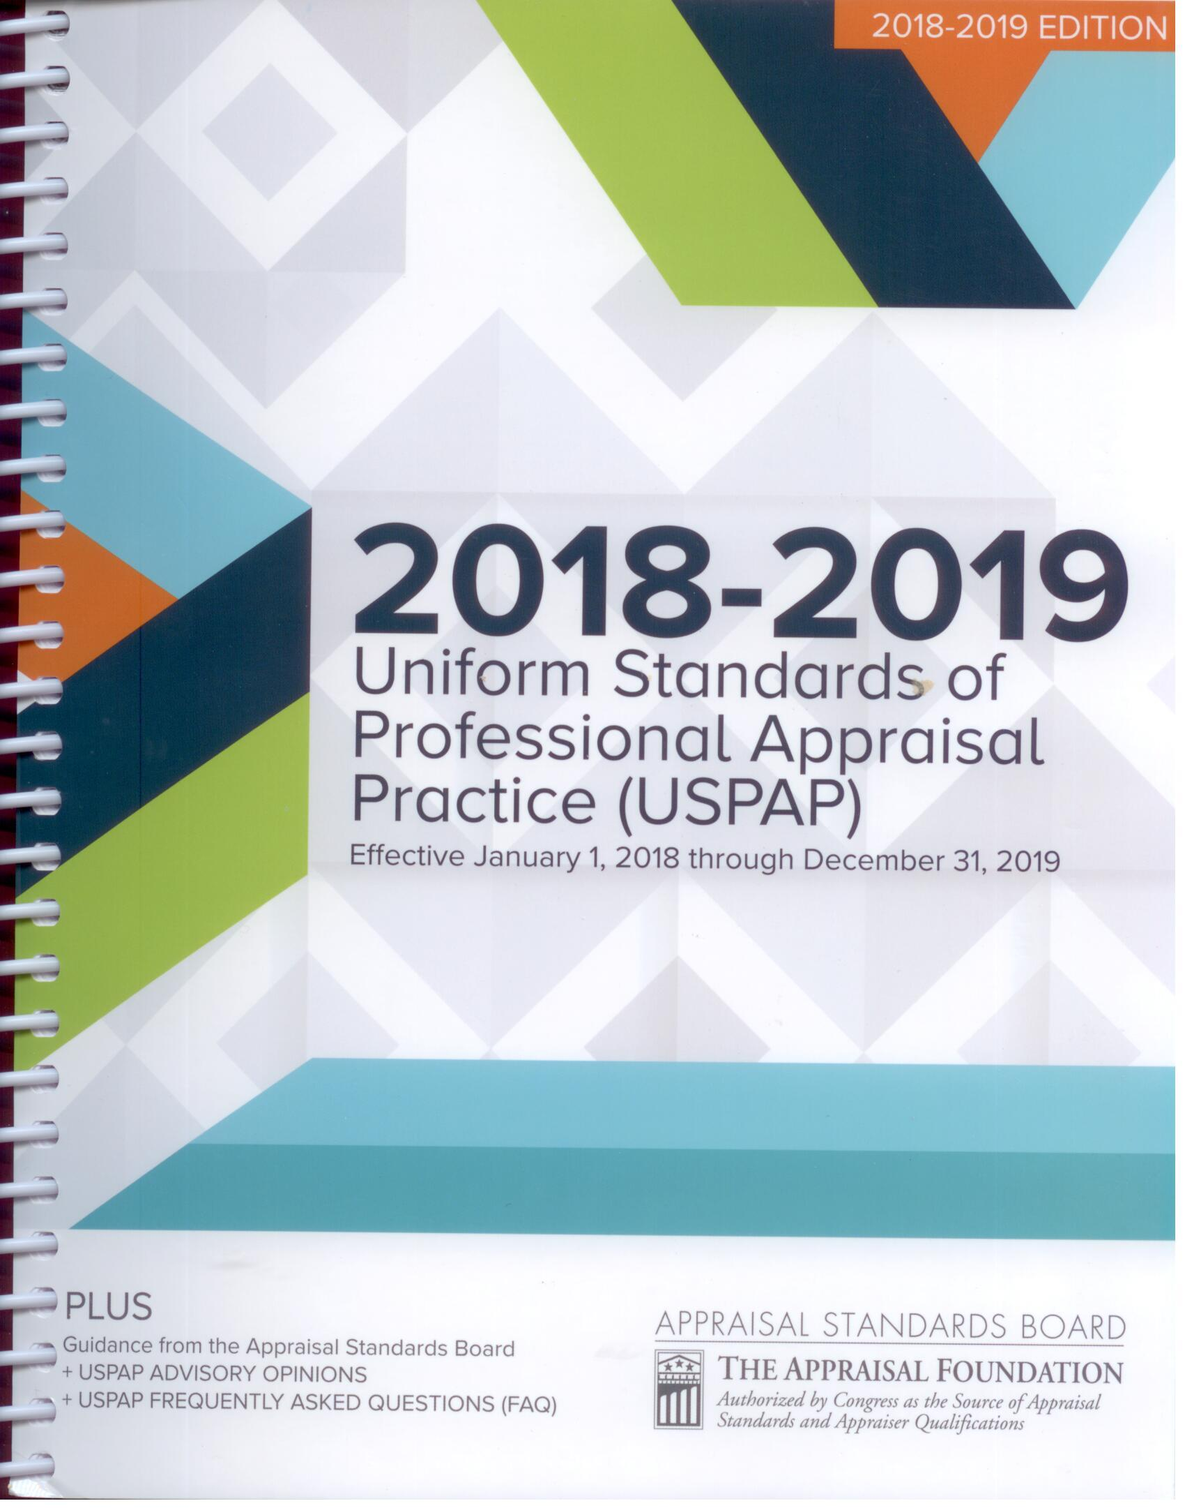
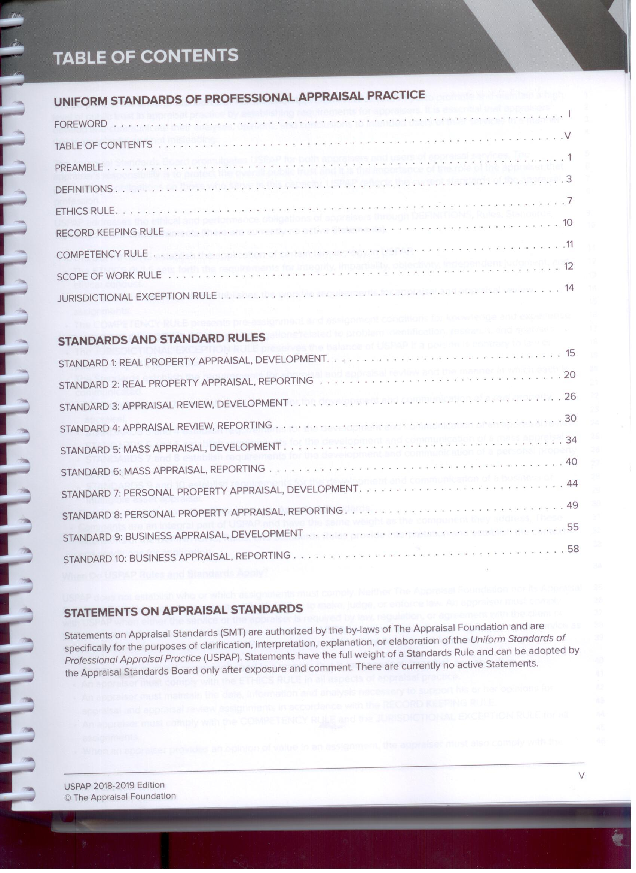
Uniform Standards of Professional Appraisal Practice (USPAP)

Slide 4
Minerals Valued by AGI
Crushed Stone
Sand & Gravel
Dimension Stone
Silica Sand (Frac Sand)
High-Purity Limestone
Coal
Potash
Clay
Gold
Gypsum
Trona
Titanium
Air Space
Water
Europeum
Roofing Granules
Industrial Plants Real Estate

Slide 5
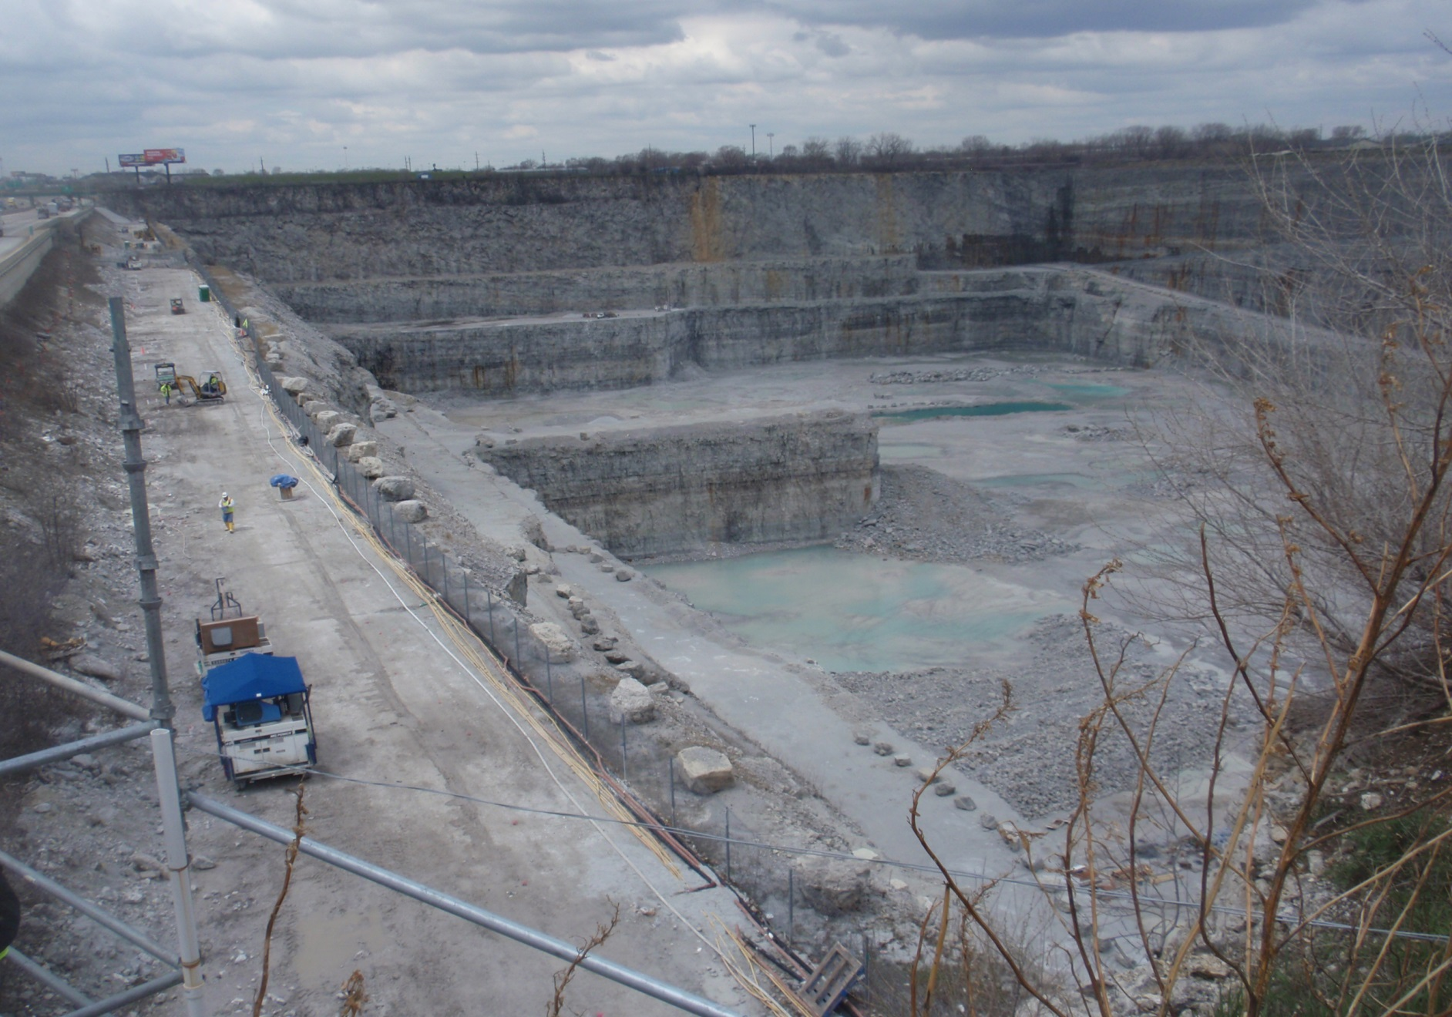
Thornton Quarry

Slide 6
Mining Operation – What Has Value – What do You own?
Property (Mineral Deposit) Identified
Permitted (Legally Mineable)
Extracted from Ground
  Surface
  Subsurface
Processed for Market - Specifications
Sell to Market
Delivered to Market – Optional
Make more $$$ than Spend $

Slide 7
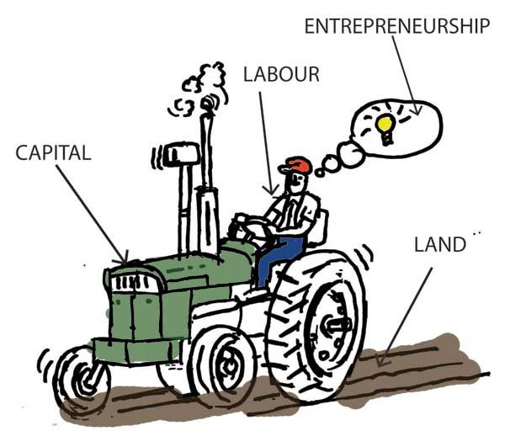
FACTORS OF PRODUCTION

Slide 8
WHAT IS AN ENTREPRENEUR??
A person who starts a business and is willing to risk loss in order to make money.
An entrepreneur has to be able to build a team that cares about their work, and to do that you have to care about how you create your team.
Imagining new ways to solve problems and create value.
It's the constant hunger for making things better and the idea that you are never satisfied with how things are.
Entrepreneurship is the mindset that allows you to see opportunity everywhere.

Slide 9
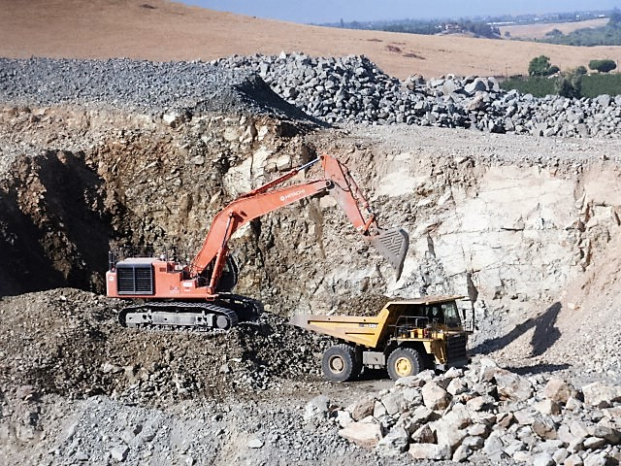
FACTORS OF PRODUCTION

Slide 10
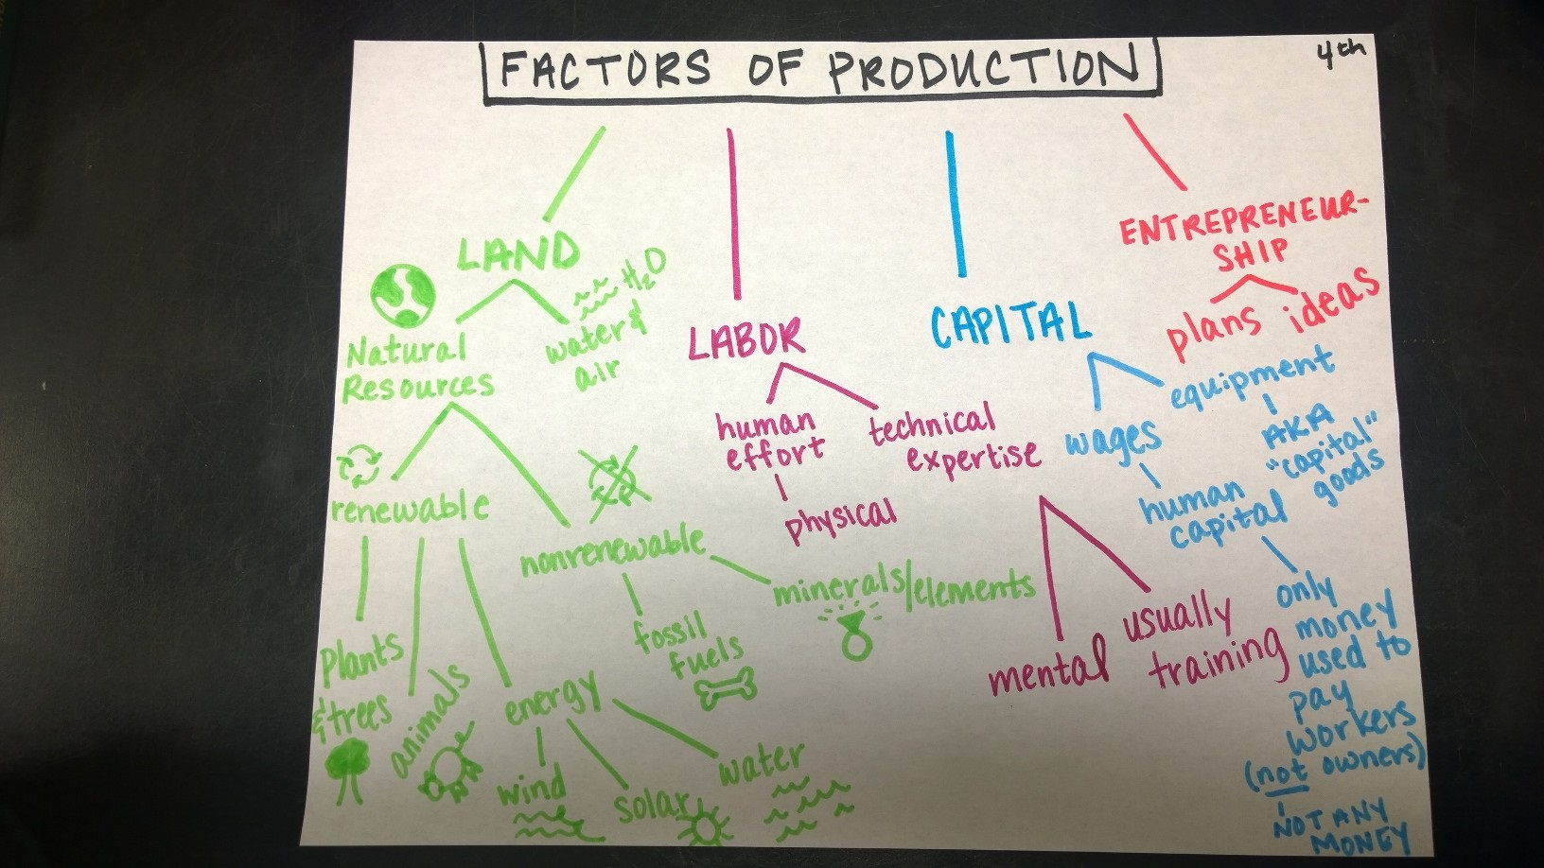
FACTORS OF PRODUCTION

Slide 11
Labor - Value Contribution
Assembled Workforce – Entrepreneurs?
“The people are tangible, but they are not property. However, the attributes of an assembly of people with special skills, team-working ability, pride of workmanship, or loyalty can be a valuable intangible business asset.”

Slide 12
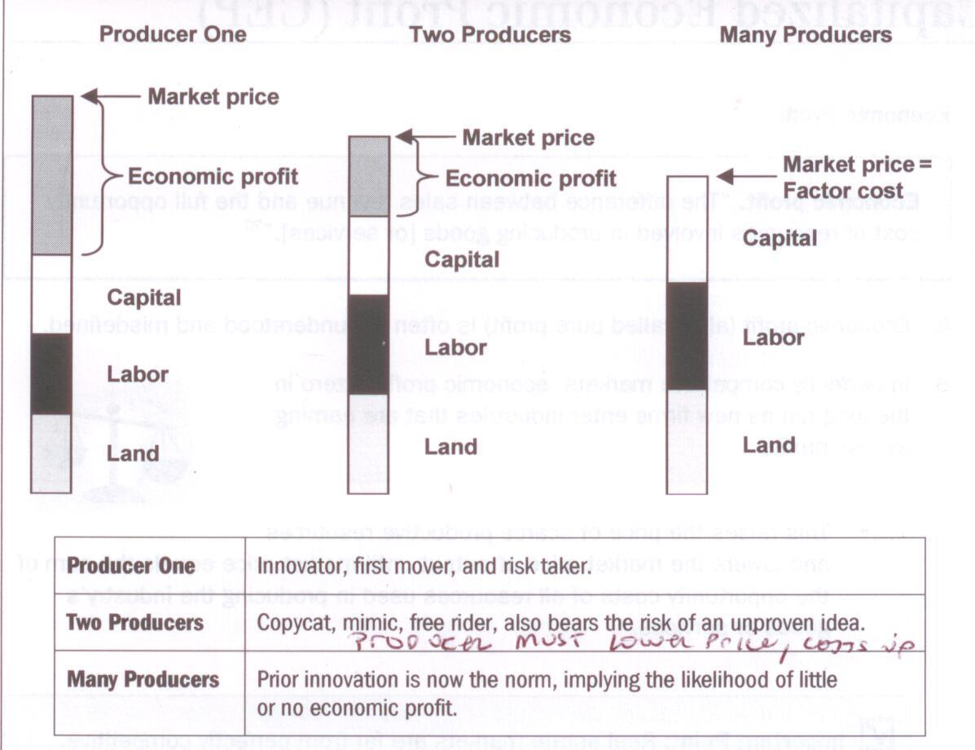
Erosion of Economic Profit

Slide 13
Valuation Approaches
Sales Comparison
  Permitted Property
Cost – Land + Improvements
  Improvements – Minimal - Permanent
    Buildings
    Shaft, Slope, Drift
    Rail or Barge
Income - DCF
  Operational Cash Flow – Total Business Value
  Royalty Cash Flow – Property (Reserves) Value
Summation – NO!!!

Slide 14
Why Appraise Mineral Properties?
Sale or Acquisition***
Tax or Estate Planning
Bankruptcy
Securities & Exchange Commission
Financing – Financial Institution***
Eminent Domain/Condemnation***
Divorce Settlement
Estate Settlement
Conservation Easements
Property Tax Appeal***
Highest and Best Use - Permitting

Slide 15
Valuation Approaches
Sale or Acquisition – Land/Assets or Business
Financing – Financial Institution – Land or Business – Collateral
Condemnation – Power to Acquire (Take) private property for public use by an agency. Subject to Just Compensation. Income generated from the property, not the business operating on the property.
Conservation Easements – Highest and Best Use
  Physically Possible
  Legally Permissible
  Financially Feasible

Slide 16
Valuation Approaches
Property Tax – Property Classification & Valuation Method
  MO & IL – Reserves were Agricultural now Commercial Class
  MO SB622/HB 2381 – Tax on Current Use – Commercial only if Reserves Permitted & Bonded
  Valuing Commercial Classification for Quarries & Pits
  “Arizona” Method – Operating Profit to Value Reserves Inappropriate
  Royalty Income Method – Property Tax, not Business Operating on Property Tax
State Tax Commission of Missouri – October 2015 – “The more assumptions made and the more variables used, increases the speculative nature of the conclusion. The more historic and actual market information utilized, the more reliable the approach.”

Slide 17
Market Value
“The most probable price which a property should bring in a competitive and open market under all conditions requisite to a fair sale, the buyer and seller each acting prudently and knowledgeably, and assuming the price is not affected by undue stimulus. Implicit in this definition is the consummation of a sale as of a specified date and the passing of title from seller to buyer …”

Slide 18
Property Ownership
Fee Ownership – complete mineral and surface rights
Surface Lease – lease surface rights
Mineral Lease – lease mineral rights
Surface Only – ownership of surface rights
Mineral Only – ownership of mineral rights

Slide 19
Land (Reserves) & Improvements
Property - Minerals/Reserves & Quality
Permit – Mineable
Buffer – Berms - Visual / Blasting / Dust
Property Line & Other Setbacks
Plant Site & Stockpile Area
Boneyard
Right-of-Way
Access - Ramp
Overburden Piles
Improvements

Slide 20
Land / Reserves

Slide 21
Reserve: Proven & Probable
Reserve – That part of a mineral deposit which could be economically and legally extracted or produced at the time of the reserve estimation.
Proven Reserve – “… sampling and measurement are spaced so closely and the geologic character is so well-defined that size, shape, depth, and mineral content of reserves are well established.”
Probable Reserve – “…The degree of assurance, although lower than that for proven reserve, is high enough to assume continuity between points of observation.”
United States SEC Form S-18
Possible Reserve

Slide 22
Reserve Estimate
Area (ac) x Thickness x Conversion Factor
Area – Physical & Legal Limitations
  Already Mined
  Setbacks
  ROW or Easements – Powerlines or Pipelines
  Plant Site/ Stockpiles/ Roads
  Shape
  Drill Hole Data
Area – Economic Limitations
  OB vs Rock Thick – Stripping
  Rock Quality

Slide 23
Income Approach – Operational Cash Flow
Annual Sales, not Production
Reserves/Resources – Mine Life
Sales Revenue
Operating Costs/SG&A
Pre-Net Operating Income/EBITDA
Capital Expenditures/Sustaining Capital
Operational Cash Flow
Discount to Present Value

Slide 24
Income Approach –
Royalty Cash Flow
Annual Sales
Reserves/Resources – Mine Life
Sales Revenue – ASP $/Ton
Royalty Rate - % ASP
Royalty Income
Discount to Present Value

Slide 25
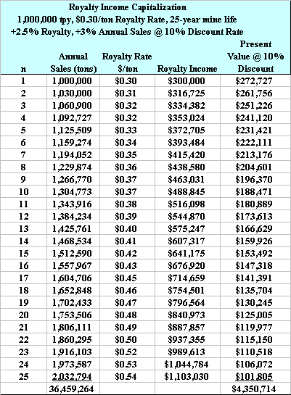

Slide 26
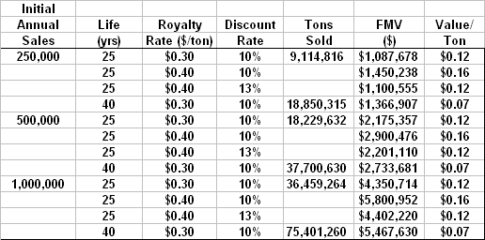

Slide 27
Going Concern
Mining Operation
Total Value = Market Value using Operational Discounted Cash Flow – Business Enterprise Value
Components of Value – Tangible Assets
  Land & Improvements/Permitted – Royalty Discounted Cash Flow or Sales Comparison
  Machinery & Equipment – Auction Values
  Stockpiles – Inventory
  Other Income – Trucks / Asphalt / Concrete
  Economic Profit – Intangible Asset
  Residual Value

Slide 28
Complex Issues in Mineral Appraisals
Excess Reserves & Residual Values
DCF - When is Year 1?
Business or Property – Tax & Condemn
Greenfield Sites Annual Sales
Nuances of the Market
  Transportation Costs
  Synergies
What is a Mineral

